Slide 1

Using Longleaf
ITS Research Computing
Karl Eklund Sandeep Sarangi Mark Reed

Slide 2
Outline
What is a (compute) cluster?
What is HTC?
  HTC tips and tricks
What is special about LL?
LL technical specifications
  types of nodes
What does a job scheduler do?
SLURM fundamentals a) submitting b) querying
File systems
Logging in and transferring files
User environment (modules) and applications
Lab exercises
Cover how to set up environment and run some commonly used apps
  SAS, R, python, matlab, ...
Notes:
Basic content slide: Add slide title and slide text in the appropriate places. To create a new slide, go to “Insert > New Slide” from the main menu.

Slide 3

What is a compute cluster?
What exactly is Longleaf?

Slide 4
What is a compute cluster?
Some Typical Components
Compute Nodes
Interconnect
Shared File System
Software
Operating System (OS)
Job Scheduler/Manager
Mass Storage

Slide 5
Compute Cluster Advantages
fast interconnect, tightly coupled
aggregated compute resources
  can run parallel jobs to access more compute power and more memory
large (scratch) file spaces
installed software base
scheduling and job management
high availability
data backup

Slide 6
Why might you use a cluster?
Working with large data files.
Needing to run jobs at scale.
Wanting access to specialized hardware: large memory, gpus, multi-core machines, etc.
Desktop is no longer sufficient.

Slide 7
General computing concepts
Serial computing: code that uses one compute core.
Multi-core computing: code that uses multiple cores on a single machine.
  Also referred to as “threaded” or “shared-memory”
  Due to heat issues, clock speeds have plateaued, you get more cores instead.
Parallel computing: code that uses more than one core
  Shared – cores all on the same host (machine)
  Distributed – cores can be spread across different machines;
Massively parallel: using thousands or more cores, possibly with an accelerator such as GPU or PHI

Slide 8

Longleaf
Geared towards HTC
  Focus on large numbers
  of serial and single node
  jobs
Large Memory
High I/O requirements
SLURM job scheduler
What’s in a name?
  The pine tree is the official state tree and 8 species of pine are native to NC including the longleaf pine.

Slide 9

Longleaf Nodes
Four types of nodes:
  General compute nodes
  Big Data, High I/O
  Very large memory nodes
  GPGPU nodes
  …

Slide 10

File Spaces

Slide 11
Longleaf Storage
Your home directory: /nas/longleaf/home/<onyen>
  Quota: 50 GB soft, 75 GB hard
Your /scratch space: /pine/scr/<o>/<n>/<onyen>
  Quota: 30 TB soft, 40 TB hard
  36-day file deletion policy
Pine is a high-performance and high-throughput parallel filesystem (GPFS; a.k.a., “IBM SpectrumScale”).
The Longleaf compute nodes include local SSD disks for a GPFS Local Read-Only Cache (“LRoC”) that optimizes the most frequent metadata data/file requests to the node itself, thus eliminating traversals of the network fabric and disk subsystem.

Slide 12

Mass Storage
long term archival storage
access via ~/ms
looks like ordinary disk file system – data is actually stored on tape
“limitless” capacity
  Actually 2 TB then talk to us
data is backed up
For storage only, not a work directory (i.e. don’t run jobs from here)
if you have many small files, use tar or zip to create a single file for better performance
Sign up for this service on onyen.unc.edu
“To infinity … and beyond” - Buzz Lightyear

Slide 13
User Environment - modules

Slide 14
Modules
The user environment is managed by modules. This provides a convenient way customize your environment. Allows you to easily run your applications.
Modules modify the user environment by modifying and adding environment variables such as PATH or LD_LIBRARY_PATH
Typically you set these once and leave them
  Optionally you can have separate named collections of modules that you load/unload

Slide 15
Using Longleaf
Once on Longleaf you can use module commands to update your Longleaf environment with applications you plan to use, e.g.
module add matlab
module save
There are many module commands available for controlling your module environment:
http://help.unc.edu/help/modules-approach- to-software-management/

Slide 16
Common Module Commands
module list
module add
module rm
module save
module avail
  module keyword
  module spider
module help
More on modules see http://help.unc.edu/CCM3_006660
http://lmod.readthedocs.org

Slide 17
Job Scheduling and Management
SLURM
Notes:
17
The Title Slide: Add the name of the presentation, the appropriate division or presenter and date of the presentation.

Slide 18
What does a Job Scheduler and batch system do?
Manage Resources
allocate user tasks to resource
monitor tasks
process control
manage input and output
report status, availability, etc
enforce usage policies

Slide 19
SLURM
SLURM is an open source, fault-tolerant, and highly scalable cluster management and job scheduling system for Linux clusters.
As a cluster workload manager, SLURM has three key functions.
  allocates exclusive and/or non-exclusive access to resources (compute nodes) to users for some duration of time so they can perform work.
  provides a framework for starting, executing, and monitoring work on the set of allocated nodes
  arbitrates contention for resources by managing a queue of pending work
https://slurm.schedmd.com/overview.html

Slide 20
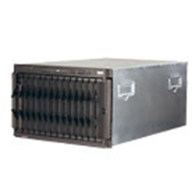
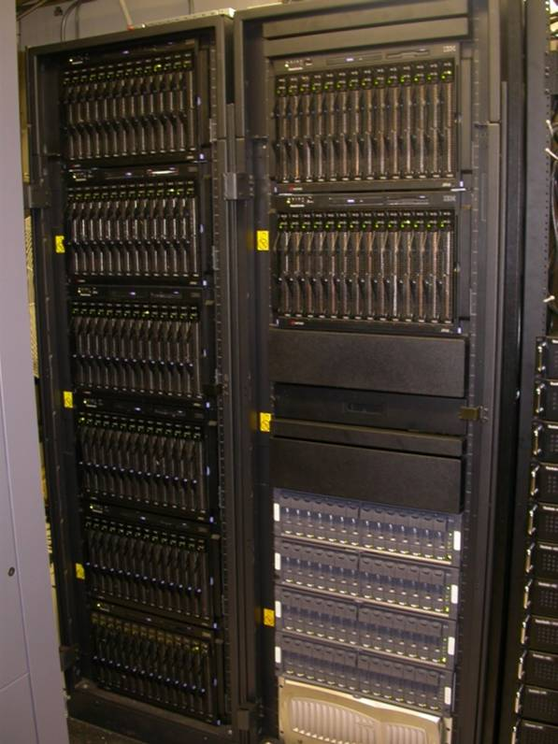
Simplified view of Batch Job Submission
Jobs Queued
job dispatched to run on available host which satisfies job requirements
Login Node
job_J
job_F
myjob
job_7
job routed to queue
sbatch myscript.sbatch
user logged in to login node submits job

Slide 21
Running Programs on Longleaf
Upon ssh-ing to Longleaf, you are on the Login node.
Programs SHOULD NOT be run on Login node.
Submit programs to one of the many, many compute nodes.
Submit jobs using SLURM via the sbatch command (more on this later).

Slide 22
Common SLURM commands
sbatch
  submit jobs
squeue – view info on jobs is scheduling queue
  squeue –u <onyen>
scancel – kill/cancel submitted job
sinfo -s
  shows all partitions
sacct – job accounting information
  sacct -j <jobid> --format='JobID,user,elapsed, cputime, totalCPU,MaxRSS,MaxVMSize, ncpus,NTasks,ExitCode‘
Use man pages to get much more info!
  man sbatch

Slide 23
Submitting Jobs: sbatch
Submit Jobs - sbatch
  Run large jobs out of scratch space, smaller jobs can run out of your home space
sbatch [sbacth_options] script_name
Common sbatch options:
  -o (--output=) <filename>
  -p (--partition=) <partition name>
  -N (--nodes=)
  --mem=
  -t (--time=)
  -J (--jobname) <name>
  -n (--ntasks) <number of tasks>
    used for parallel threaded jobs

Slide 24
Two methods to submit non-interactive batch jobs
The most common method is to submit a job run script (see following examples)
  sbatch myscript.sl
  The file (you create) has #SBATCH entries, one per option followed by the command you want to run
Second method is to submit on the command line using the --wrap option and to include the command you want to run in quotes (“ ”)
  sbatch [sbatch options] --wrap “command to run”

Slide 25
SLURM terminology
SLURM groups nodes into collections called “partitions” and each partition has a name.
On Longleaf the “general” partition has the general compute nodes and big data nodes, the “bigmem” partition has the bigmem nodes, and the “gpu” and “volta-gpu” partitions have the gpu nodes.
The partitions also serve special purposes, i.e. the “interact” partition is for interactive jobs, the “bigmem” partition is for very large memory jobs, the “gpu” and “volta-gpu” partitions are for gpu jobs, etc.

Slide 26
SLURM specialized partitions
SNP (Single Node Parallel)
The SNP partition is designed to support parallel jobs that are not wide enough to warrant multimode processing on Dogwood, yet require a sufficient percentage of cores/memory from single node to be worthwhile scheduling a full node.
Available upon request only, with PI approval.
Need “-p snp” and “—qos=snp_access”

Slide 27
Interactive job submissions
To bring up the Matlab GUI:
srun -n1 -p interact --x11=first matlab
-singleCompThred
To bring up the Stata GUI:
salloc -n1 -p interact --x11=first xstata-se
To bring up a bash session:
srun -n1 -p interact --x11=first --pty /bin/bash
Note. For the GUI to display locally you will need a X connection to the cluster.

Slide 28
Matlab sample job submission script #1
#!/bin/bash
#SBATCH -p general
#SBATCH -N 1
#SBATCH -t 07-00:00:00
#SBATCH --mem=10g
#SBATCH -n 1
matlab -nodesktop -nosplash -singleCompThread -r mycode -logfile mycode.out
Submits a single cpu Matlab job.
general partition, 7-day runtime limit, 10 GB memory limit.

Slide 29
Matlab sample job submission script #2
#!/bin/bash
#SBATCH -p general
#SBATCH -N 1
#SBATCH -t 02:00:00
#SBATCH --mem=3g
#SBATCH -n 24
matlab -nodesktop -nosplash -singleCompThread -r mycode -logfile mycode.out
Submits a 24-core, single node Matlab job (i.e. using Matlab’s Parallel Computing Toolbox).
general partition, 2-hour runtime limit, 3 GB memory limit.

Slide 30
Matlab sample job submission script #3
#!/bin/bash
#SBATCH -p gpu
#SBATCH -N 1
#SBATCH -t 30
#SBATCH --qos gpu_access
#SBATCH --gres=gpu:1
#SBATCH -n 1
matlab -nodesktop -nosplash -singleCompThread -r mycode -logfile mycode.out
Submits a single-gpu Matlab job.
gpu partition, 30 minute runtime limit.

Slide 31
Matlab sample job submission script #4
#!/bin/bash
#SBATCH -p bigmem
#SBATCH -N 1
#SBATCH -t 7-
#SBATCH --qos bigmem_access
#SBATCH -n 1
#SBATCH --mem=500g
matlab -nodesktop -nosplash -singleCompThread -r mycode -logfile mycode.out
Submits a single-cpu, single node large memory Matlab job.
bigmem partition, 7-day runtime limit, 500 GB memory limit

Slide 32
R sample job submission script #1
#!/bin/bash
#SBATCH -p general
#SBATCH -N 1
#SBATCH -t 07-00:00:00
#SBATCH --mem=10g
#SBATCH -n 1
R CMD BATCH --no-save mycode.R mycode.Rout
Submits a single cpu R job.
general partition, 7-day runtime limit, 10 GB memory limit.

Slide 33
R sample job submission script #2
#!/bin/bash
#SBATCH -p general
#SBATCH -N 1
#SBATCH -t 02:00:00
#SBATCH --mem=3g
#SBATCH -n 24
R CMD BATCH --no-save mycode.R mycode.Rout
Submits a 24-core, single node R job (i.e. using one of R’s parallel libraries).
general partition, 2-hour runtime limit, 3 GB memory limit.

Slide 34
R sample job submission script #3
#!/bin/bash
#SBATCH -p bigmem
#SBATCH -N 1
#SBATCH -t 7-
#SBATCH --qos bigmem_access
#SBATCH -n 1
#SBATCH --mem=500g
R CMD BATCH --no-save mycode.R mycode.Rout
Submits a single-cpu, single node large R memory job.
bigmem partition, 7-day runtime limit, 500 GB memory limit

Slide 35
Python sample job submission script #1
#!/bin/bash
#SBATCH -p general
#SBATCH -N 1
#SBATCH -t 07-00:00:00
#SBATCH --mem=10g
#SBATCH -n 1
python mycode.py
Submits a single cpu Python job.
general partition, 7-day runtime limit, 10 GB memory limit.

Slide 36
Python sample job submission script #2
#!/bin/bash
#SBATCH -p general
#SBATCH -N 1
#SBATCH -t 02:00:00
#SBATCH --mem=3g
#SBATCH -n 24
python mycode.py
Submits a 24-core, single node Python job (i.e. using one of python’s parallel packages).
general partition, 2-hour runtime limit, 3 GB memory limit.

Slide 37
Python sample job submission script #3
#!/bin/bash
#SBATCH -p bigmem
#SBATCH -N 1
#SBATCH -t 7-
#SBATCH --qos bigmem_access
#SBATCH -n 1
#SBATCH --mem=500g
python mycode.py
Submits a single-cpu, single node large Python memory job.
bigmem partition, 7-day runtime limit, 500 GB memory limit

Slide 38
Stata sample job submission script #1
#!/bin/bash
#SBATCH -p general
#SBATCH -N 1
#SBATCH -t 07-00:00:00
#SBATCH --mem=10g
#SBATCH -n 1
stata-se -b do mycode.do
Submits a single cpu Stata job.
general partition, 7-day runtime limit, 10 GB memory limit.

Slide 39
Stata sample job submission script #2
#!/bin/bash
#SBATCH -p general
#SBATCH -N 1
#SBATCH -t 02:00:00
#SBATCH --mem=3g
#SBATCH -n 8
stata-mp -b do mycode.do
Submits a 8-core, single node Stata/MP job.
general partition, 2-hour runtime limit, 3 GB memory limit.

Slide 40
Stata sample job submission script #3
#!/bin/bash
#SBATCH -p bigmem
#SBATCH -N 1
#SBATCH -t 7-
#SBATCH --qos bigmem_access
#SBATCH -n 1
#SBATCH --mem=500g
stata-se -b do mycode.do
Submits a single-cpu, single node large Stata memory job.
bigmem partition, 7-day runtime limit, 500 GB memory limit

Slide 41
Printing Job Info at end (using Matlab script #1)
#!/bin/bash
#SBATCH -p general
#SBATCH -N 1
#SBATCH -t 07-00:00:00
#SBATCH --mem=10g
#SBATCH -n 1
matlab -nodesktop -nosplash -singleCompThread -r mycode -logfile mycode.out
sacct -j $SLURM_JOB_ID --format='JobID,user,elapsed, cputime, totalCPU,MaxRSS,MaxVMSize, ncpus,NTasks,ExitCode'
sacct command at the end prints out some useful information for this job. Note the use SLURM environment variable with the jobid
The format picks out some useful info. See “man sacct” for a complete list of all options.

Slide 42
Run job from command line
You can submit without a batch script, simply use the --wrap option and enclose your entire command in double quotes (“ “)
Include all the additional sbatch options that you want on the line as well
sbatch -t 10:00 -n 1 -o slurm.%j --wrap=“R CMD BATCH --no-save mycode.R mycode.Rout”

Slide 43
Email example
#!/bin/bash
#SBATCH --partition=general
#SBATCH --nodes=1
#SBATCH --time=04-16:00:00
#SBATCH --mem=6G
#SBATCH --ntasks=1
# comma separated list
#SBATCH --mail-type=BEGIN, END
#SBATCH --mail-user=YOURONYEN@email.unc.edu
# Here are your mail-type options: NONE, BEGIN, END, FAIL,
# REQUEUE, ALL, TIME_LIMIT, TIME_LIMIT_90, TIME_LIMIT_80,
# ARRAY_TASKS
date
hostname
echo "Hello, world!"

Slide 44
Dependencies
Job 1:
#!/bin/bash
#SBATCH --job-name=My_First_Job
#SBATCH --partition=general
#SBATCH --nodes=1
#SBATCH --time=04:00:00
#SBATCH --ntasks=1
sleep 10
Job 2:
-bash-4.2$ cat job2.sbatch
#!/bin/bash
#SBATCH --job-name=My_Second_Job
#SBATCH --partition=general
#SBATCH --nodes=1
#SBATCH --time=04:00:00
#SBATCH --ntasks=1
sleep 10
% sbatch job1.sbatch
Submitted batch job 5405575
% sbatch --dependency=after:5405575 job2.sbatch
Submitted batch job 5405576
Other options:
sbatch --dependency=after:5405575 job2.sbatch
sbatch --dependency=afterany:5405575 job2.sbatch
sbatch --dependency=aftercorr:5405575 job2.sbatch
sbatch --dependency=afternotok:5405575 job2.sbatch
sbatch --dependency=afterok:5405575 job2.sbatch
sbatch --dependency=expand:5405575 job2.sbatch
sbatch --dependency=singleton job2.sbatch

Slide 45
Scaling up workflow
Use SLURM job arrays (Matlab example):
#!/bin/bash
#SBATCH -N 1
#SBATCH -n 1
#SBATCH -p general
#SBATCH -t 1-
#SBATCH --array=1-30
matlab -nodesktop -nosplash -singleCompThread -r 'main('$SLURM_ARRAY_TASK_ID')'

Slide 46
Submit SNP job
Use Single Node Parallel Partition
#!/bin/bash
#SBATCH -N 1
#SBATCH -n 36
#SBATCH -p snp
#SBATCH –qos=snp_access
#SBATCH -t 1-00:00:00
#SBATCH --array=1-30
mpirun myParallelCode

Slide 47
Workflow tips
First use an interactive session in the interact partition to debug your code.
Then submit a few test jobs to the interact using a SLURM submission script to make sure the job submission is correct.
When you’ve verified everything is working as expected run the actual jobs in the general partition.
Only ask for resources you need. Don’t over specify resources (particularly the memory limit!)
Keep your working directory well organized.

Slide 48
Demo
Lab Exercises

Slide 49
Sample workflow
cd ~
cp -r /pine/scr/d/e/deep/walkthrough .

Slide 50
Supplemental Material

Slide 51
Longleaf – General Compute Nodes
Intel Xeon processers, E5-2680 v3
Haswell microarchitecture (22 nm lithography)
Dual socket, 12-core (24 cores per node)
  Hyperthreading is on so 48 scheduable threads
2.50 GHz processors for each core
DDR4 memory, 2133 MHz
9.6 GT/s QPI
256 GB memory
30 MB L3 cache
1x400 GB-SSD
2x 10Gbps Ethernet
120 MW TDP

Slide 52
Longleaf – Big Data Nodes
Intel Xeon processers, E5-2643 v3
Haswell microarchitecture (22 nm lithography)
Dual socket, 6-core (12 cores per node)
  Hyperthreading is on so 24 scheduable threads
3.40 GHz processors for each core
DDR4 memory, 2133 MHz
9.6 GT/s QPI
256 GB memory
20 MB L3 cache
2x800 GB-SSD
2x 10Gbps Ethernet
135 MW TDP

Slide 53
Longleaf – Extreme Memory Nodes
Intel Xeon processers, E7-8867 v3
Haswell microarchitecture (22 nm lithography)
Quad socket, 16-core (64 cores per node)
  Hyperthreading is on so 128 scheduable threads
2.50 GHz processors for each core
DDR4 memory, 2133 MHz
9.6 GT/s QPI
3.0 TB memory
45 MB L3 cache
1.6 TB SSD
2x 10Gbps Ethernet
165 MW TDP

Slide 54
Longleaf – GPU Nodes, Compute Host
Intel Xeon processers, E5-2623 v4
Broadwell microarchitecture (14 nm lithography)
Dual socket, 4-core (8 cores per node)
  Hyperthreading is on so 16 scheduable threads
2.60 GHz processors for each core
DDR4 memory, 2133 MHz
8.0 GT/s QPI
64 GB memory
10 MB L3 cache
no SSD
2x 10Gbps Ethernet
85 MW TDP

Slide 55

Longleaf – GPU Nodes, Device
Nvidia GeForce GtX 1080 graphics card
Pascal Architecture
8 GPUs per node
2560 CUDA cores per GPU
1.73 GHz clock
8 GB Memory
320 GB/s mem b/w
PCIe 3.0 bus

Slide 56
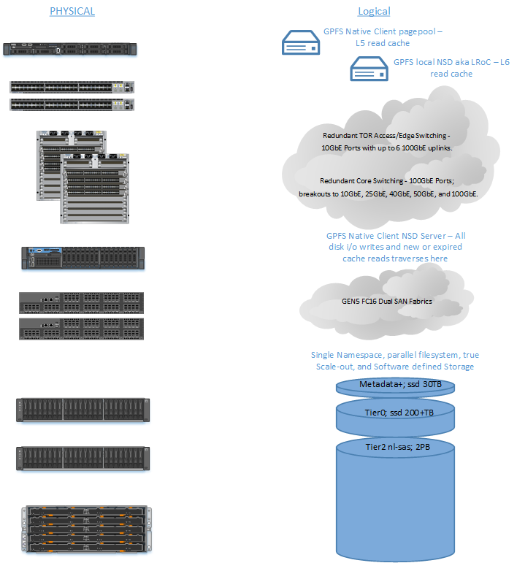
Tiered storage on Longleaf

Slide 57

Getting an account:
To apply for your Longleaf or cluster account simply go to
http://onyen.unc.edu
Subscribe to Services

Slide 58
Login to Longleaf
Use ssh to connect:
  ssh longleaf.unc.edu
  ssh onyen@longleaf.unc.edu
SSH Secure Shell with Windows
  see http://shareware.unc.edu/software.html
For use with X-Windows Display:
  ssh –X longleaf.unc.edu
  ssh –Y longleaf.unc.edu
Off-campus users (i.e. domains outside of unc.edu) must use VPN connection

Slide 59

X Windows
An X windows server allows you to open a GUI from a remote machine (e.g. the cluster) onto your desktop. How you do this varies by your OS
Linux – already installed
Mac - get Xquartz which is open source
  https://www.xquartz.org/
MS Windows - need an application such as X-win32. See
  http://help.unc.edu/help/research-computing-application-x-win32/

Slide 60
File Transfer
Different platforms have different commands and applications you can use to transfer files between your local machine and Longleaf:
Linux– scp, rsync
  scp: https://kb.iu.edu/d/agye
  rsync: https://en.wikipedia.org/wiki/Rsync
Mac- scp, Fetch
  Fetch: http://software.sites.unc.edu/shareware/#f
Windows- SSH Secure Shell Client, MobaXterm
  SSH Secure Shell Client: http://software.sites.unc.edu/shareware/#s
  MobaXterm: https://mobaxterm.mobatek.net/

Slide 61
File Transfer
Globus– good for transferring large files or large numbers of files. A client is available for Linux, Mac, and Windows.
  http://help.unc.edu/?s=globus
  https://www.globus.org/

Slide 62
Links
Longleaf page with links
  http://help.unc.edu/subject/research-computing/longleaf
SLURM examples
  http://help.unc.edu/help/getting-started-example-slurm-on-longleaf
Linux cheat sheet:
  https://files.fosswire.com/2007/08/fwunixref.pdf
Basic Linux tutorial:
  http://faculty.washington.edu/rjl/uwhpsc-coursera/unix.html
Advanced Linux tutorial (very well written!):
  http://linuxcommand.org/lc3_learning_the_shell.php
Emacs reference:
  https://www.gnu.org/software/emacs/refcards/pdf/refcard.pdf

