Slide 1
SAS Deep Learning
Object Detection, Keypoint Detection
Xindian Long
2018.09

Slide 2
Outline
Introduction
Object Detection Concept and the YOLO Algorithm
Object Detection Example (CAS Action)
Facial Keypoint Detection Example (DLPy)

Slide 3
Why SAS Deep Learning
Seamlessly integrated into SAS Viya as one of components on the end-to-end analytics platform
Support many common layers / FCMP to define new act/loss/layers
Focused on tuning/pruning the models for faster and smaller models
Easily managed and readily deployed on SAS ESP with CPUs/GPUs.
Import open source models from Caffe and Keras
SAS DL has Keras-style Python APIs (DLPy).

Slide 4
Computer Vision Tasks (1)
Slides Borrowed from Feifei Li, Serena Yeung & Justin Johnson’s Deep Learning Class Slides

Slide 5
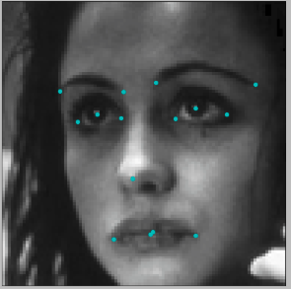
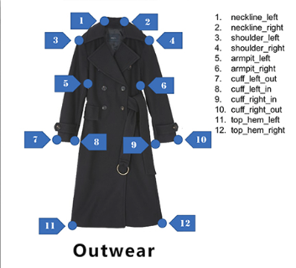
Computer Vision Tasks (2)
Keypoint Detection

Slide 6
Introduction
Object Detection Concept and the YOLOv2 Algorithm
Object Detection Example (CAS Action)
Facial Keypoint Detection Example (DLPy)

Slide 7
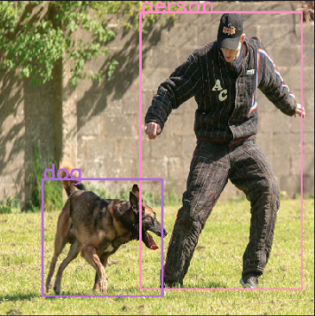
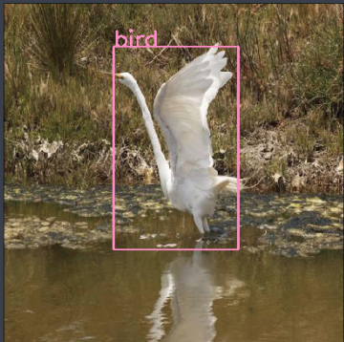
Object Detection?
Bounding box of an object
The category of the object

Slide 8
Two Types of Object Detection Methods
Single-shot Multi-shot
Single-shot Methods
    Bounding box localization and object classification done at the same time
  YOLO
  SSD
Multi-shot Methods
    Region proposal first
    For each region, do classification and box regression
  Faster R-CNN
  R-FCN
  Faster R-CNN slower but more accurate, YOLO faster but less accurate

Slide 9
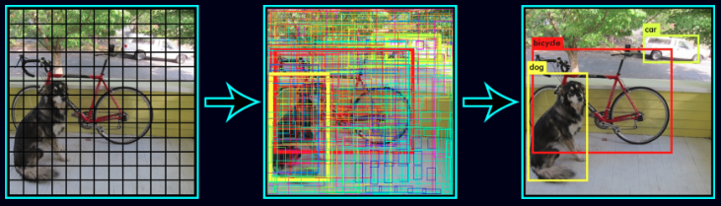
YOLO v2
Pictures from YOLOv2 web site by the original author:
https://pjreddie.com/darknet/yolov2/
Separate images into regions
In each region, predict pre-set number of bounding boxes (with predefined shapes), as well as their object confidence, and class probabilities
Select predictions with high probabilities
Defined by Anchor Boxes

Slide 10
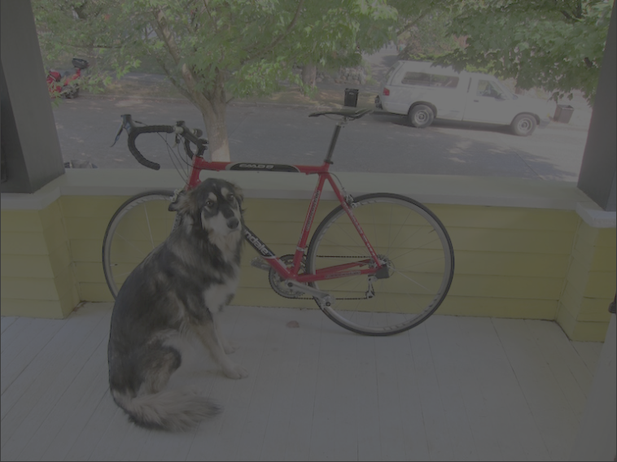
YOLO v2
Anchor Boxes
Predicting pre-set number of bounding boxes
(with predefined shapes) in each region
Anchor Boxes
Obtained using from the data (k-means algorithm)
Capture prior knowledge about object size/shape
Different boxes to detect objects with different shapes
Final detected object shape maybe slightly different from the original anchor boxes’ shape

Slide 11
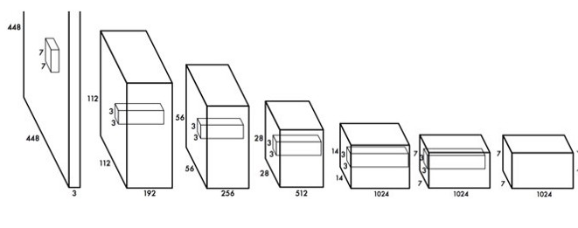
YOLO Network Architecture
Object Class and Bounding Boxes
Images
CNN Layers to Extract Feature
The Detection Layer
One example of model DAG for the YOLO detector

Slide 12
Introduction
Object Detection Concept and the YOLOv2 Algorithm
Object Detection Example (CAS Action)
Facial Keypoint Detection Example (DLPy)

Slide 13
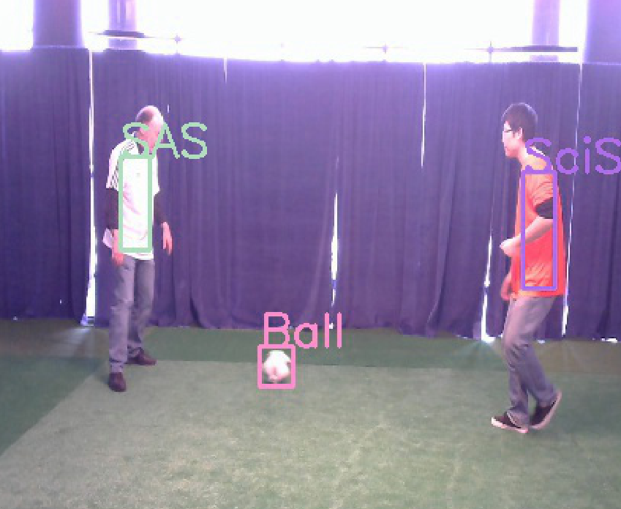
Object Detection Example
Objective: Soccer and Player Detection

Slide 14
Object Detection Using YOLOv2
In CAS Action
Import, Connect, and Load Action Sets
from swat import *
s = CAS('dlgrd009.unx.sas.com', 29998, nworkers=1)
s.loadactionset('image')
s.loadactionset('deepLearn')

Slide 15
Load Data
whereStr = "_nObjects_>0"
s.table.loadtable(casout={'name':'trainSet', 'replace':True, 'blocksize':350},
caslib='demolib',path='demo07/sgfTrainingSet.sashdat', where=whereStr)
trainSetTbl = s.CASTable('trainSet')
s.numrows('trainSet')
s.table.loadtable(casout={'name':'testSet', 'replace':True, 'blocksize':350},
caslib='demolib',path='demo07/sgfTestingSet.sashdat', where=whereStr)
testSetTbl = s.CASTable('testSet')
s.numrows('testSet')

Slide 16
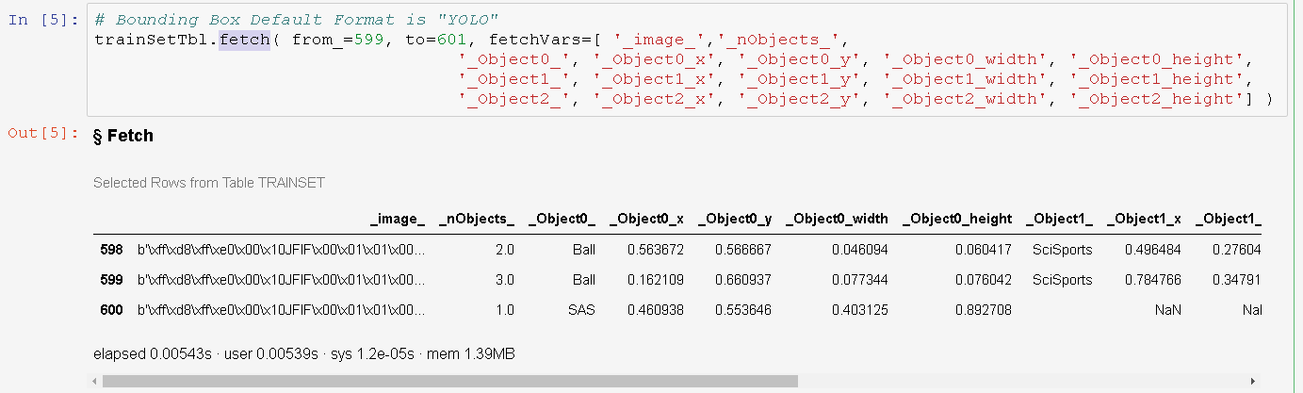
Table Content

Slide 17
Build the Model DAG
nclasses = 3;
predictionsPerGrid = 3;
s.addLayer(
model = modelName,
name = 'conv9',
layer = dict(
type = 'convolution',
nFilters = (nclasses + 5) * predictionsPerGrid,
width = 1,
height = 1,
stride = 1,
std = 1e-1,
noBias = True,
act = 'identity'
),
srcLayers = ['bn8']
)
modelName = 'TINY-YOLOV2-SGF';
s.buildModel(
model = dict(
name = modelName,
replace = True
),
type = 'CNN'
)
addCNNLayers (s, modelName)

Slide 18
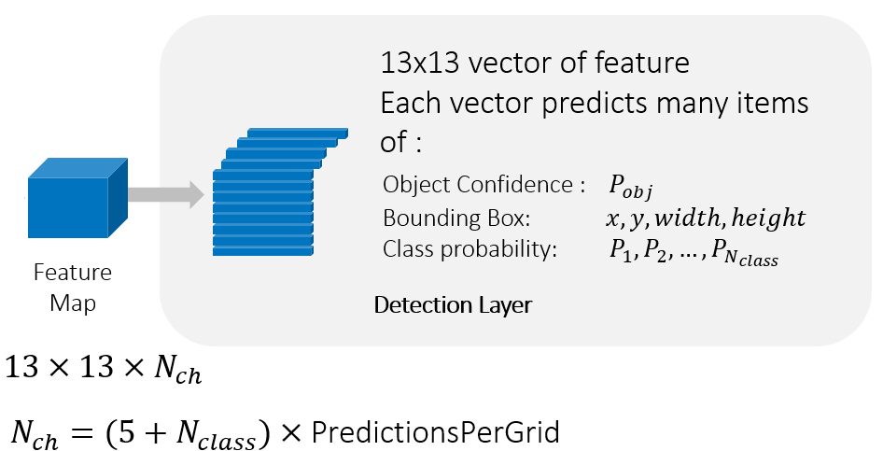
Input Feature Map to the Detection Layer

Slide 19
Add the Detection Layer
s.addLayer(
model = modelName, name = 'detection0',
layer = dict(
type = 'detection’, detectionModelType = "YOLOV2",
classNumber = nclasses, # Number of object categories
gridNumber = 13, # Number of regions in each image row(col)
predictionsPerGrid = predictionsPerGrid, # Equals the number of anchor boxes
anchors = anchors, # A vector defines anchor boxes
detectionThreshold = 0.3, # Threshold to select predictions with high probability
iouThreshold = 0.8, # Threshold to eliminate duplicate detection
srcLayers = ['conv9']
)

Slide 20
Load Weighs
s.table.loadtable(
  casout={'name':'Darknet_Reference_weights','replace':True},
  caslib='demolib’,
  path="DL_MODELS/Darknet_Reference_weights2.sashdat");
Weight pre-trained over ImageNet data for classification tasks
Will do transferred learning using the feature extraction layers

Slide 21
Train the Model
r=s.dlTrain (table=trainSetTbl, # CAS Table containing input images and labels
modelTable='TINY-YOLOV2-SGF’, # CAS Table containing model DAG
optimizer=optimizer, # The optimizing algorithm and parameters
gpu = dict(devices={1}), # We are using GPU to train
initWeights=dict(name = 'Darknet_Reference_weights', # The initial weights for training
where='_layerid_<21'), # We only take the weights of feature extraction CNN layers
modelWeights=dict(name = 'TinyYoloV2Demo'), # The CAS table to save final trained weights
dataspecs=[ # To assign data to different layers
dict(type='IMAGE', layer='data', data=inputVars), # Table columns used by the data layer
dict(type='OBJECTDETECTION', layer='detection0', data=targets) # Table columns used by the detection layer
],
forceEqualPadding = True,
seed=13309, recordSeed = 13309, nthreads=1)
inputVars ['_image_’]
targets ['_nObjects_', '_Object0_', '_Object0_x', '_Object0_y', '_Object0_width', '_Object0_height’,
'_Object1_', '_Object1_x', '_Object1_y', '_Object1_width', '_Object1_height’,
'_Object2_', '_Object2_x', '_Object2_y', '_Object2_width', '_Object2_height']

Slide 22
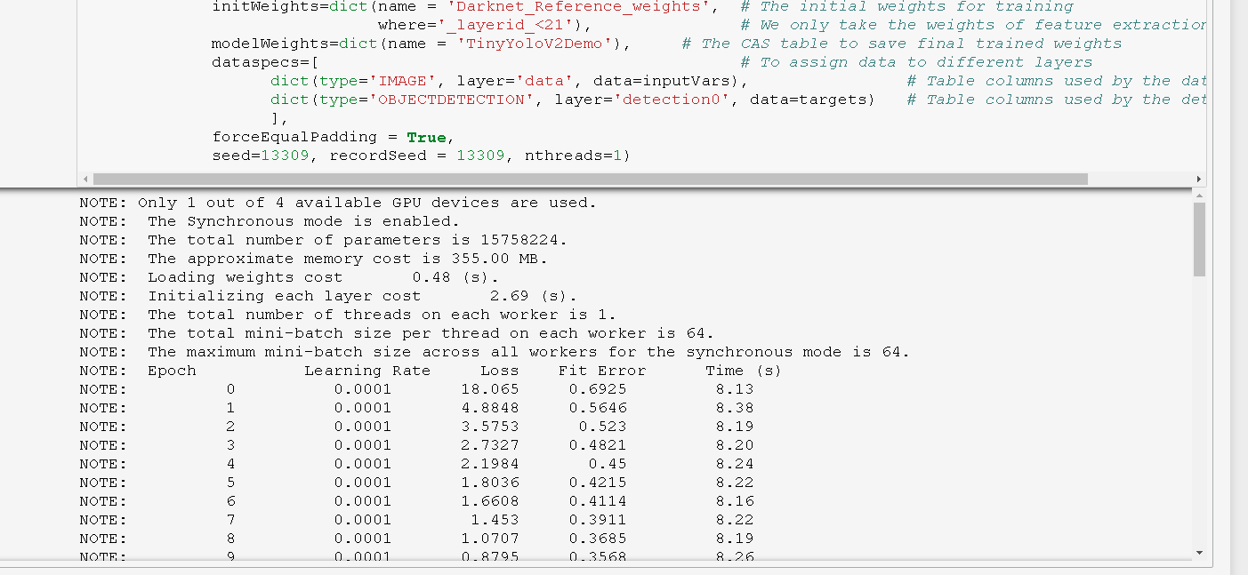
Training

Slide 23
Scoring
sres= s.dlscore (
model='TINY-YOLOV2-SGF', # CAS Table containing Model DAG
randommutation='none', # Not using random mutation to the input image
initWeights='TinyYoloV2Demo’, # CAS Table containing the weights used to do the scoring
table = testSetTbl, # CAS Table containing the testing images
copyVars=['_path_', '_image_’], # CAS Table columns copied to the output table by the action
nThreads=3,
gpu=1,
casout={'name':'detections', 'replace':True} # CAS Table to save the detection output
)

Slide 24
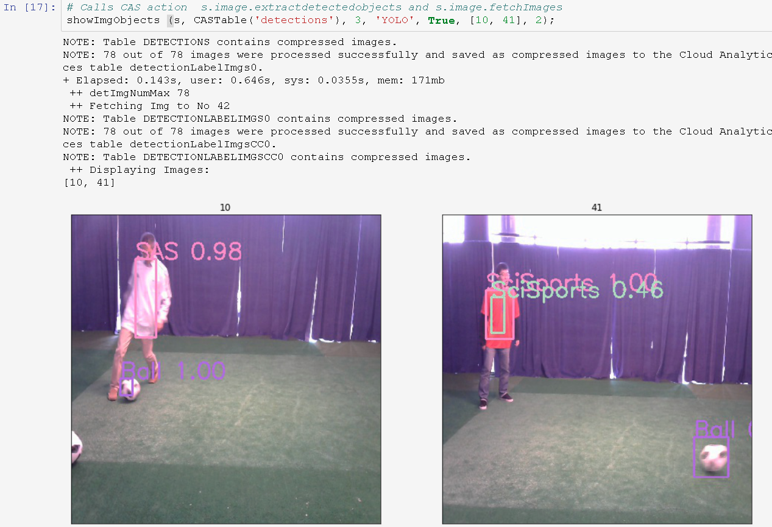
Visualizing Detection Results

Slide 25
Introduction
Object Detection Concept and the YOLOv2 Algorithm
Object Detection Example (CAS Action)
Facial Keypoint Detection Example (DLPy)

Slide 26
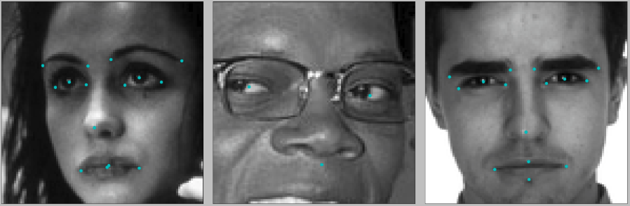
Facial Keypoints Detection in DLPy
Face Keypoints Detection
  Objective
    Predict keypoint position on face images
  Potential applications
    Tracking faces in images and videos
    Analysis facial expressions
    Detecting dysmorphic facial signs for medical analysis
    Biometric / Face recognition

Slide 27
Import DLPy and Connect to SAS
from swat import *
from dlpy import Model, Sequential
from dlpy.layers import *
from dlpy.applications import *
from dlpy.utils import *
from dlpy.images import ImageTable
s = CAS('sasserver.demo.sas.com', 5570, 'sasdemo', 'Orion123')
s.loadactionset('deepLearn')
s.loadactionset('image')

Slide 28
Build the Model
model.add(Conv2d(n_filters=128, width=3, act='relu', stride=1))
model.add(Pooling(width=2, height=2, stride = 2, pool='max'))
model.add(Dense(n=500, act='relu'))
model.add(Dense(n=500, act='relu'))
# new feature, keypoints layer
model.add(KeyPointsLayer(n=30))
model_name='facial_keypoints'
model = Sequential(conn=s, model_table=model_name)
model.add(InputLayer(n_channels=1, width=96, height=96, scale = 1.0 / 255))
model.add(Conv2d(n_filters=32, width=3, act='relu', stride=1))
model.add(Pooling(width=2, height=2, stride = 2, pool='max'))
model.add(Conv2d(n_filters=64, width=3, act='relu', stride=1))
model.add(Pooling(width=2, height=2, stride = 2, pool='max'))

Slide 29
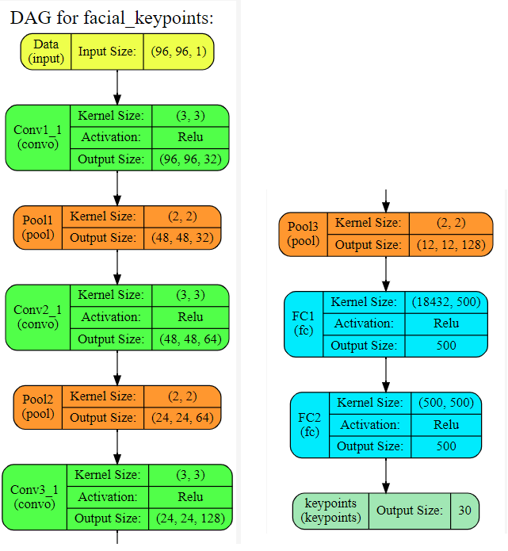
Plot the Network Architecture
model.plot_network()

Slide 30
Ready to Use Models
LeNet5
VGG16, VGG19
ResNet18, ResNet34, ResNet50, ResNet101, ResNet152, ResNetWide
DenseNet121
Darknet
YOLOv2, Tiny_YOLOv2
E.g.
model = YOLOv2(…)

Slide 31
Prepare for Training
Load, training data, test data, initWeights
s.table.addcaslib(activeonadd=False,
name='dnfs',path=path,subdirectories=False)
s.table.loadtable(casout={'name':'trainSet', 'replace':True, 'blocksize':350},
caslib='dnfs',path='FacialKeyPoints.sashdat')
s.table.loadtable(casout={'name':'initweights', 'replace':True, 'blocksize':350},
caslib='dnfs',path='facial_keypoints_det_workshop_initweights.sashdat’)
s.shuffle(table=dict(name='trainSet'), casout=dict(name='train', blocksize=4,replace=True))

Slide 32
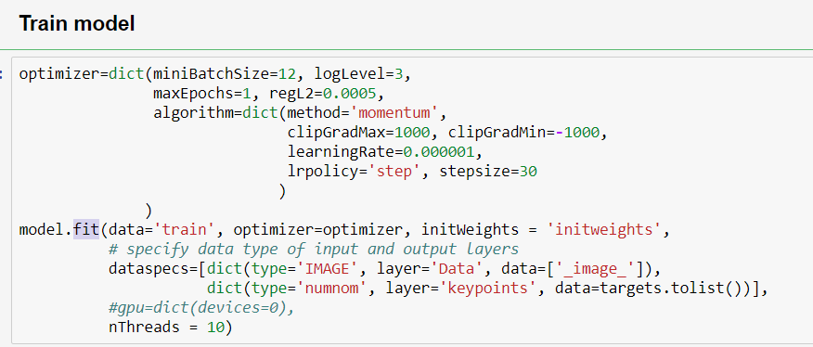
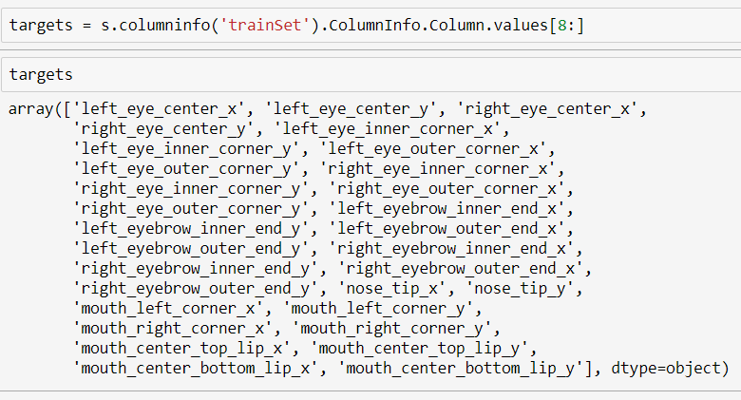
Train the Keypoint Detection Model

Slide 33
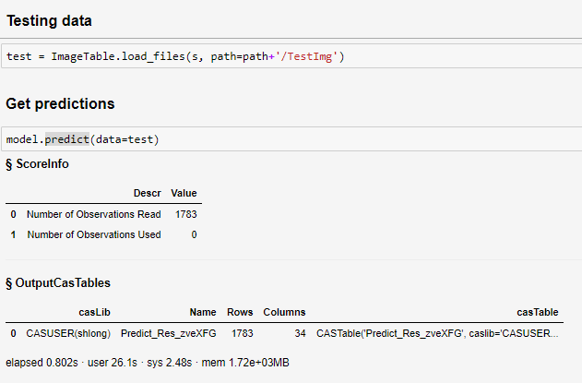
Predict Using Trained Weights

Slide 34
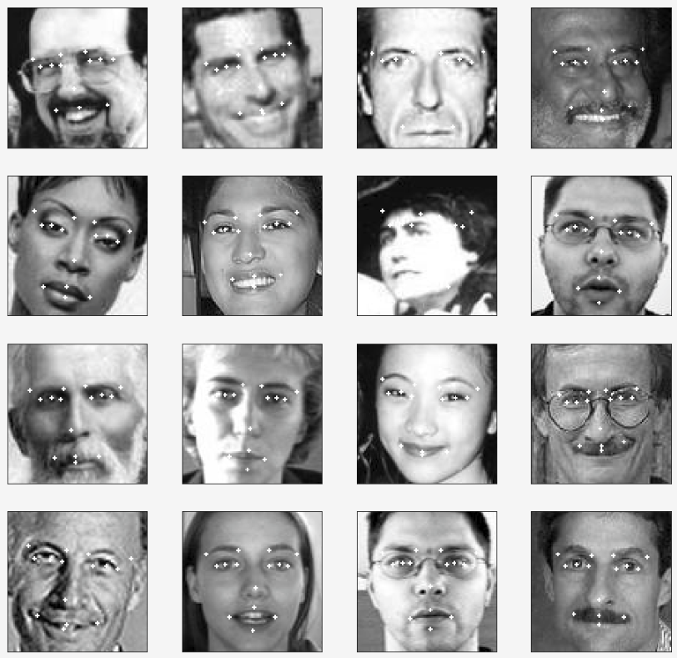
Keypoint Prediction Results

Slide 35
Summary
SAS Deep Learning supports end-to-end computer vision application development
  Classification
  Object detection
  Keypoint detection
  Semantic segmentation
  Instance segmentation
CAS Action API
  Soccer player and ball detection
DLPy API
  Facial keypoints detection

Slide 36
References
“YOLO9000:Better, Faster, Stronger”, Joseph Redmony, Ali Farhadi
“SSD: Single Shot MultiBox Detector”, Wei Liu1, Dragomir Anguelov, etc.
“Faster R-CNN: Towards Real-Time Object Detection with Region Proposal Networks” , Shaoqing Ren, Kaiming He, Ross Girshick, and Jian Sun
“R-FCN: Object Detection via Region-based Fully Convolutional Networks”, Jifeng Dai, Yi Li, Kaiming He, Jian Sun
“OverFeat: Integrated Recognition, Localization and Detection using Convolutional Networks”, Pierre Sermanet, David Eigen, Xiang Zhang, Michael Mathieu, Rob Fergus, Yann LeCun

Slide 37


