Slide 1
Implementing AI Systems with Interpretability
Ilknur Kaynar-Kabul

Slide 2
What Will We Cover?
Agenda
Understanding and interpreting your dataset
Insights about inner workings of Deep Neural Networks
Methods to interpret predictions given by a black box model
Interpretability from the perspective of a model consumer

Slide 3
Why?
What?
Where?
How?

Slide 4
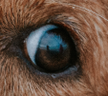
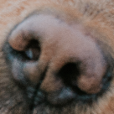
Interpretability Enables Trust in AI Models
Understand the drivers behind a trained model
What are the top inputs?
Neural network
for image recognition
Data scientist
Image source: https://unsplash.com/

Slide 5
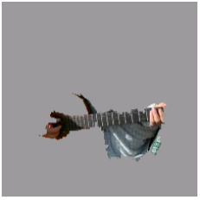
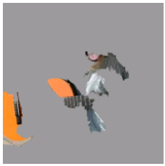
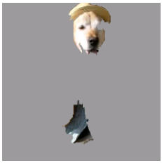
Interpretability Enables Trust in AI Models
Understand the reasons behind a prediction
How did you make this prediction?
Electric guitar
(p=0.32)
Acoustic guitar
(p=0.24)
Labrador
(p=0.21)
Neural network
for image recognition
Data scientist
"Why Should I Trust You?": Explaining the Predictions of Any Classifier Marco Tulio Ribeiro, Sameer Singh, Carlos Guestrin.
ACM SIGKDD, 2016

Slide 6
Interpretability Enables Trust in AI Models
Figure out when NOT to trust a model
Prediction accuracy is very high. It is time to put this system online.
You are detecting snow, not wolves!
I can`t trust you
Neural network
to predict
wolf vs husky
Data scientist
"Why Should I Trust You?": Explaining the Predictions of Any Classifier Marco Tulio Ribeiro, Sameer Singh, Carlos Guestrin.
ACM SIGKDD, 2016

Slide 7
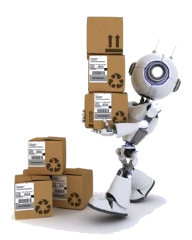
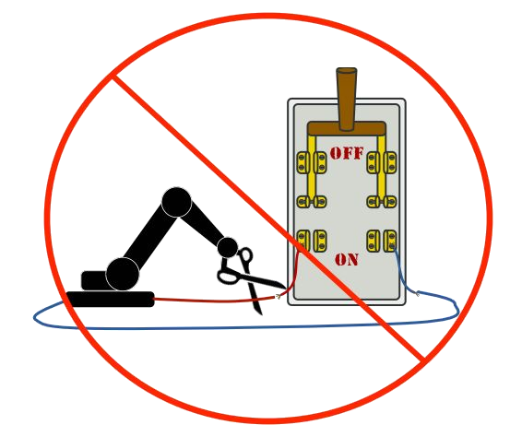
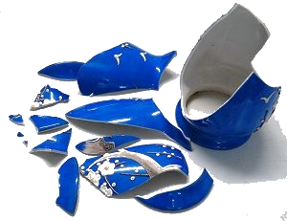
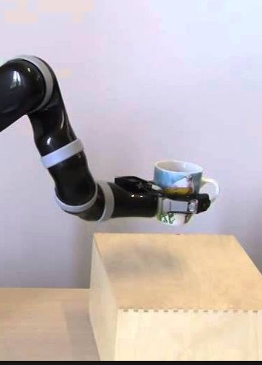
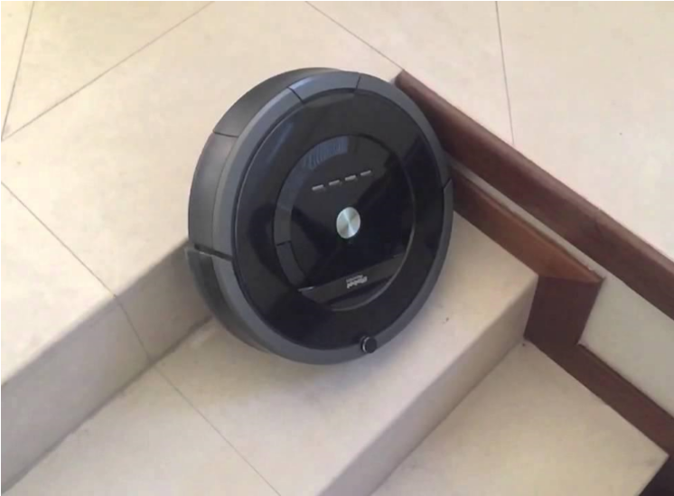
Interpretability Enables Trust in AI Agents
Achieve precision and robustness
Side Effects
Reward Gaming
Off Switch
Safe Exploration
Distributional Shift
Source: http://s.interpretable.ml/nips_interpretable_ml_2017_victoria_Krakovna.pdf Krakovana et al

Slide 8
Who Needs It?
Can I improve my model?
Which model should I pick?
How can I communicate the results?
How will I understand the results?
Am I being treated fairly?
What can I change for a more positive outcome?
Does the model make fair decisions?
Is it transparent?
Is it acceptable?
Fair
Accountable
Transparent
Trustworthy
Explainable
Data scientist
Consumer/end user
Policy makers/regulators

Slide 9
Interpretability, Transparency and Trust
Pre-modelling
Modelling
Design
Selection
Post-modelling
Prototypes
Embedding
Topology
Relationships
Representations
Operations
Unknowns

Slide 10
Interpretability, Transparency and Trust
Pre-modelling
Modelling
Design
Selection
Post-modelling
Prototypes
Embedding
Topology
Relationships
Representations
Operations
Unknowns
Understanding and Interpreting Your Data Set

Slide 11
Summary Statistics with Visualization
Understand the characteristics of the data and provide preliminary information on how the data is distributed

Slide 12
Example-based Exploration
Hard to interpret millions of rows with thousands of columns
Find observations and dimensions
To characterize
To criticize
To distinguish
Image source: https://unsplash.com/

Slide 13
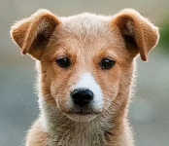
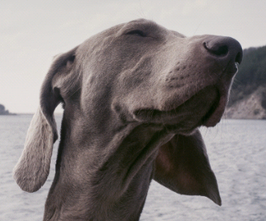
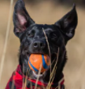
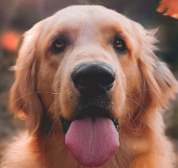
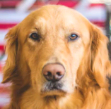
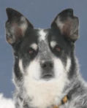
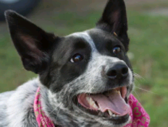
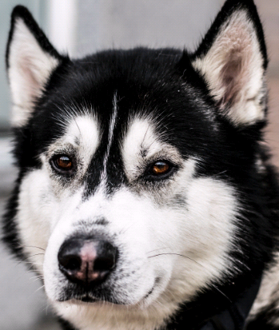
Characterize
Find observations that best describes clusters (prototypes)
Prototype
Prototype
Examples are not Enough, Learn to Criticize! Criticism for Interpretability
Been Kim, Rajiv Khanna and Sanmi Koyejo Neural Information Processing Systems 2016
Image source: https://unsplash.com/

Slide 14
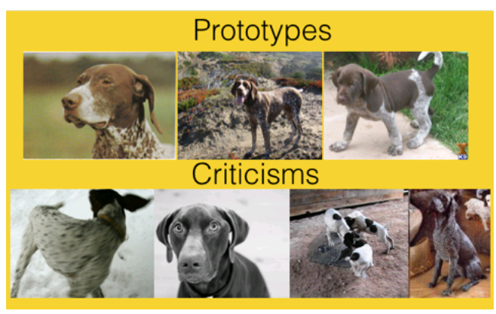
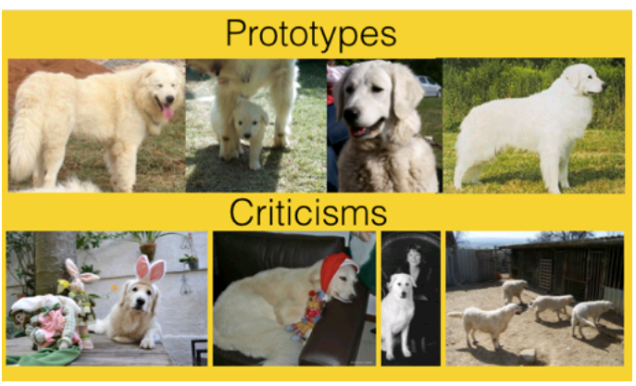
Criticize
Find minority observations that do not quite fit the model
Examples are not Enough, Learn to Criticize! Criticism for Interpretability
Been Kim, Rajiv Khanna and Sanmi Koyejo Neural Information Processing Systems 2016
Image source: https://unsplash.com/

Slide 15
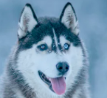
Distinguish
Find dimensions that best characterize and distinguish between clusters
Golden Retriever
Husky
Mind the Gap: A Generative Approach to Interpretable Feature Selection and Extraction,
Been Kim, Finale Doshi-Velez and Julie Shah Neural Information Processing Systems 2015
Image source: https://unsplash.com/

Slide 16
Embedding
Reduce dimension to see the variations, groups, patterns in your data set
Image source: https://unsplash.com/

Slide 17
Embedding
Reduce dimension to see the variations, groups, patterns in your data set
Visualizing High-Dimensional Data Using t-SNE.
L.J.P. van der Maaten and G.E. Hinton.
Journal of Machine Learning Research 9(Nov):2579-2605, 2008.
Image source: https://unsplash.com/

Slide 18
Topological Data Analysis
Mapper algorithm
Topological Methods for the Analysis of High Dimensional Data Sets and 3D Object Recognition
Gurjeet Singh, Facundo Memoli, Gunnar Carlsson
Eurographics Symposium on Point-Based Graphics (2007)

Slide 19
Interpretability, Transparency and Trust
Pre-modelling
Modelling
Design
Selection
Post-modelling
Prototypes
Embedding
Topology
Relationships
Representations
Operations
Unknowns
Insights about Inner Workings of Deep Neural Networks

Slide 20
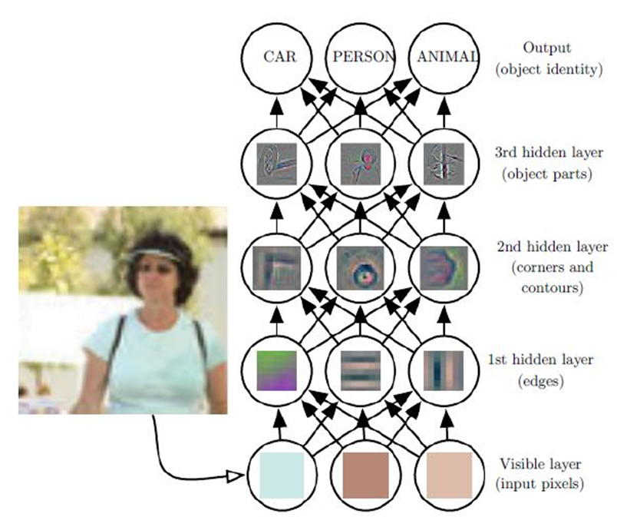
Neural Networks Learn the Features and the Mapping from the Features to Output
Visualizing and Understanding Convolutional Networks, Zeiler, M. and Fergus, R. Proc. of the IEEE European Conference on Computer Vision 2014,
Image Source: http://www.deeplearningbook.org/, Goodfellow et al.

Slide 21
Reverse Engineering the Black Box
Optimize Inputs to Activate a Particular Neuron
Feature Visualization - Distill.pub
https://distill.pub/2017/feature-visualization
C Olah, ‎2017

Slide 22
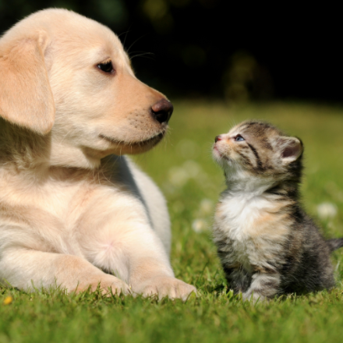
Reverse Engineering the Black Box
Feature Visualization
Attribution
Feature Visualization - Distill.pub
https://distill.pub/2017/feature-visualization
C Olah, ‎2017

Slide 23
Engineering Neural Networks for Interpretability
Case Based Reasoning Through Prototypes
Deep Learning for Case-Based Reasoning through Prototypes: A Neural Network that Explains Its Predictions.
Oscar Li, Hao Liu, Chaofan Chen, Cynthia Rudin

Slide 24
Engineering Predictors for Interpretability
Using Shallow Decision Tree to Simulate Neural Network Prediction
Data $(X, y)$
Predict $\hat{y}$
Train Tree on $(X,\hat{y})$
Beyond Sparsity: Tree Regularization of Deep Models for Interpretability
Mike Wu , Michael C. Hughes , Sonali Parbhoo , Maurizio Zazzi , Volker Roth , and Finale Doshi-Velez

Slide 25
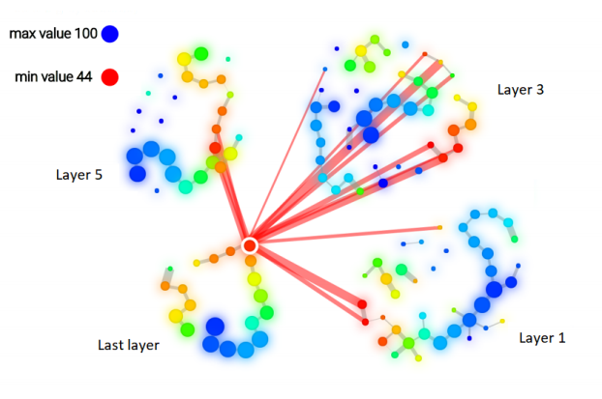
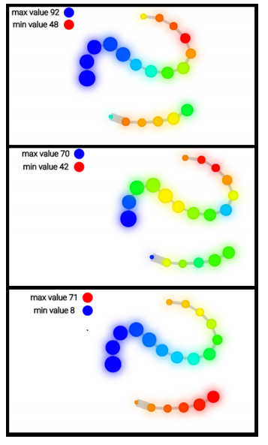
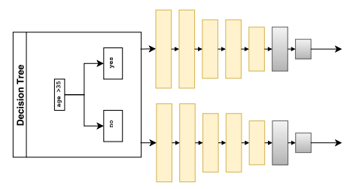
Profiling and Refining Deep Neural Networks
M-boost: Uses topological data analysis to summarize neural network’s inner representations and profiles regions in the inner features space.
M-Boost: Profiling and Refining Deep Neural Networks with Topological Data Analysis
Gregory Naitzat, Namita Lokare, Jorge Silva, Ilknur Kaynar-Kabul
KDD IDEA Workshop 2018

Slide 26
Interpretability, Transparency and Trust
Pre-modelling
Modelling
Design
Selection
Post-modelling
Prototypes
Embedding
Topology
Relationships
Representations
Operations
Unknowns
Methods to Interpret Predictions Given by a Black Box Model

Slide 27
Reinforcement Learning
$$Agent$$
Reward
Decision
$$Environment$$

Slide 28
Reverse Engineering AI Agent’s Representations
Aggregated states on the T-SNE map
Graying the black box: Understanding DQNs
Tom Zahavy, Nir Ben-Zrihem, Shie Mannor ;
Proceedings of The 33rd International Conference on Machine Learning, PMLR 48:1899-1908, 2016.

Slide 29
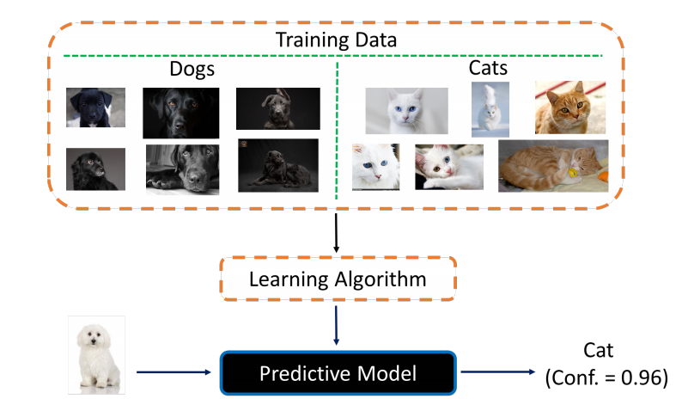
Identifying Unknowns
Representations and policies for guided exploration
Identifying Unknown Unknowns in the Open World: Representations and Policies for Guided Exploration
Himabindu Lakkaraju, Ece Kamar, Rich Caruana, Eric Horvitz

Slide 30
Input-Output Relationship
Question | Technique
What are the top inputs? | Variable Importance
How do the drivers work? | Partial Dependence (PD) Individual Conditional Expectation (ICE)
What is the explanation for a particular prediction? | Local Interpretable Model-agnostic Explanations (LIME)
Model agnostic
Visual
Can be used to compare models

Slide 31
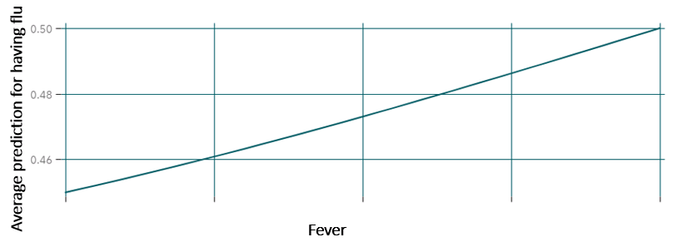
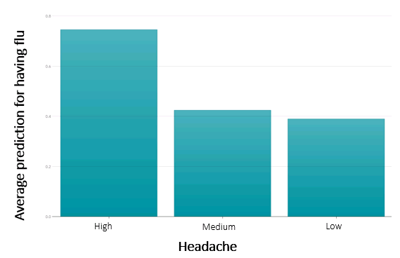
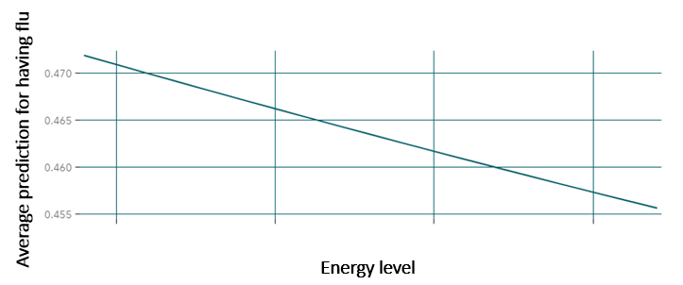
Partial Dependence (PD)
Gives marginal effect of selected input variable (or multiple variables) on target

Slide 32
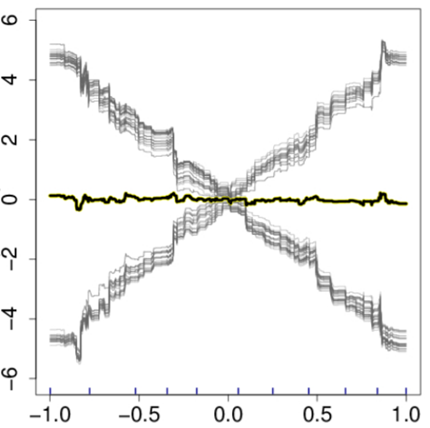
Individual Conditional Expectation (ICE)
Can help identify subgroups (additive effects) and interactions
Subgroups of individuals
PD function
Peeking Inside the Black Box: Visualizing Statistical Learning with Plots of Individual Conditional Expectation
Goldstein, A., Kapelner, A., Bleich, J., and Pitkin, E. (2014).
Notes:
Show the individual variation around the PD curve, which is an average at each X value.

Slide 33
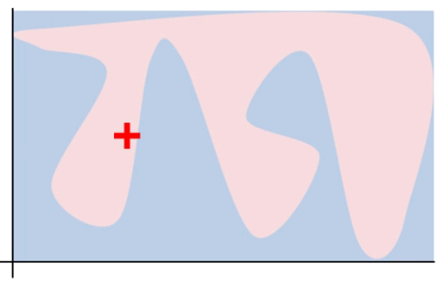
Local Interpretable Model-agnostic Explanations (LIME)
Gives explanations for individuals predictions from a classifier
Local approximation
LIME builds an interpretable model of explanatory data samples at local areas in the analyzed data.
"Why Should I Trust You?": Explaining the Predictions of Any Classifier Marco Tulio Ribeiro, Sameer Singh, Carlos Guestrin.
ACM SIGKDD, 2016

Slide 34
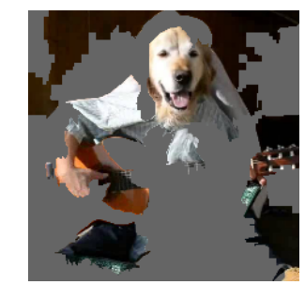
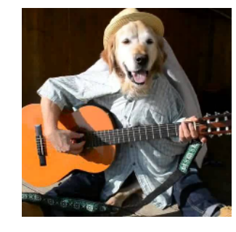
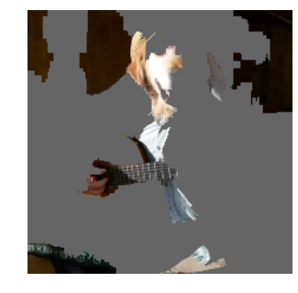
Local Interpretable Model-agnostic Explanations (LIME)
Perturbed Instances | P(Labrador)
0.92
Locally weighted
regression
0.001
Original Image
P(labrador) = 0.21
0.34
Explanation
Image Source: https://drive.google.com/file/d/0ByblrZgHugfYZ0ZCSWNPWFNONEU/view

Slide 35
Interpretability, Transparency and Trust
Pre-modelling
Modelling
Design
Selection
Post-modelling
Prototypes
Embedding
Topology
Relationships
Representations
Operations
Unknowns
Interpretability from the perspective of a model consumer

Slide 36
Demonstrations for Real Estate Pricing

Slide 37
Example: House Sale Prices
What does affect the price of our house besides location?
Image Source: maps.google.com
Data Source: https://www.kaggle.com/harlfoxem/housesalesprediction

Slide 38
Data

Slide 39
Principal Component Analysis

Slide 40
T-SNE

Slide 41
T-SNE

Slide 42
T-SNE

Slide 43
Partial Dependence (PD)
Gradient boosting

Slide 44
Partial Dependence (PD)
Random forest

Slide 45
Individual Conditional Expectation (ICE)
Random forest

Slide 46
LIME for n=1
Variable Name | Value
price | 575,000
P_price | 622,062
bathrooms | 2
bedrooms | 3
sqft_above | 2,690
sqft_basement | 0
sqft_lot | 435,600
yr_built | 1,992
waterfront | No

Slide 47
LIME for n=20
Variable Name | Value
price | 428,000
P_price | 421,793
bathrooms | 1.75
bedrooms | 3
sqft_above | 1,280
sqft_basement | 840
sqft_lot | 9,350
yr_built | 1,979
waterfront | No

Slide 48
Implementing AI Systems with Interpretability, Transparency, and Trust
Interpretability enables trust in AI systems.
Data scientists, consumers and policy makers seek explainable decisions.
Building explainable AI systems starts from understanding and interpreting the datasets and application domain.
Sophisticated models can be engineered for interpretations and explanations.
Post-modelling techniques can shed a light into the models.
Implementing AI systems requires a close collaboration between AI and domain experts and utilizing an arsenal of tools.

Slide 49
More Resources
For more information on this subject, follow our blog post series:
https://blogs.sas.com/content/subconsciousmusings/2017/12/18/interpretability-crucial-trusting-ai-machine-learning/

