Slide 1
Using Dogwood
Instructor:
Mark Reed
markreed@unc.edu

Slide 2
Outline
What is a (compute) cluster?
Dogwood technical specifications
  types of nodes
File spaces
What does a job scheduler do?
User environment (modules) and applications
SLURM fundamentals a) submitting b) querying
Job submit examples
Notes:
Basic content slide: Add slide title and slide text in the appropriate places. To create a new slide, go to “Insert > New Slide” from the main menu.

Slide 3
What is a compute cluster?

Slide 4
What is a compute cluster?
Some Typical Components
  Compute Nodes
  Interconnect
  Shared File System
  Software
  Operating System (OS)
  Job Scheduler/Manager
  Mass Storage

Slide 5
Compute Cluster Advantages
fast interconnect, tightly coupled
aggregated compute resources
  can run parallel jobs to access more compute power and more memory
large (scratch) file spaces
installed software base
scheduling and job management
high availability
data backup

Slide 6
General computing concepts
Serial computing: code that uses one compute core.
Multi-core computing: code that uses multiple cores on a single machine.
  Also referred to as “threaded” or “shared-memory”
  Due to heat issues, clock speeds have plateaued, you get more cores instead.
Parallel computing: code that uses more than one core
  Shared – cores all on the same host (machine)
  Distributed – cores can be spread across different machines;
Massively parallel: using thousands or more cores, possibly with an accelerator such as GPU or PHI

Slide 7

Dogwood
Geared towards HPC
  Focus on running many core, tightly coupled, computational models
Low latency, high bandwidth switching fabric
Large Memory
SLURM job scheduler
What’s in a name?
  The blossom of the Dogwood tree was designated as the official state flower of North Carolina in 1941.

Slide 8

Dogwood Nodes
Three types of nodes:
  The majority of the nodes are Intel Xeon processors with the Broadwell-EP microarchitecture
  50 nodes of Intel Xeon Skylake
  20 nodes of Intel Xeon Phi, Knight’s Landing

Slide 9
Dogwood Nodes
183 original general purpose compute nodes
  Xeon E5-2669A v4 2.40 GHz
  Dual Socket, 22 cores/socket, 44 physical cores total
  512 GB RAM
  309.2 TF Rpeak using these nodes
  Racks c-201-* thru c-209-* except c-205 is for switching. 24 Nodes/rack except for c-209 which has 15.
50 Skylake nodes
  Intel Xeon Gold 6148 processers, 2.4 GHz processors
  Dual socket, 20-core (40 cores per node)
  384 GB memory
  Skylake microarchitecture (14 nm lithography)
  Racks c-211-* and c-212-*. 25 nodes/rack
20 Knight’s Landing nodes
  Racks c-210-*

Slide 10
IB Interconnect
Mellanox EDR Infiniband (IB)
9 Leaf switches
6 core switches
Each EDR link is 100 Gb/s bidirectional
2:1 blocking ratio outside the rack
non-blocking within a rack (24 nodes, 1056 cores)

Slide 11
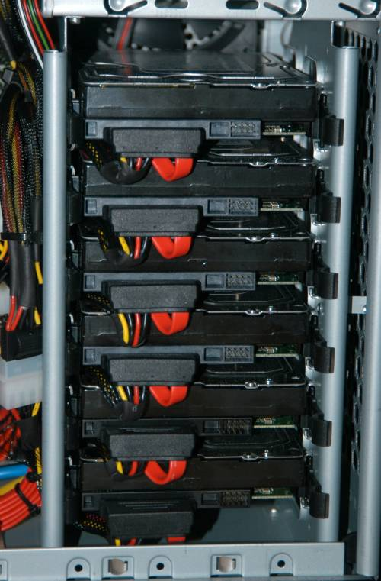
File Spaces

Slide 12
Dogwood Storage
The SAME home file system is mounted on BOTH Longleaf and Dogwood
Your home directory: /nas/longleaf/home/<onyen>
  Quota: 50 GB soft, 75 GB hard
Your scratch space: /21dayscratch/scr/<o>/<n>/<onyen>
  Quota: 15 TB soft, 17TB hard
  21-day file deletion policy
  247 TB total usable disk space

Slide 13

Mass Storage
long term archival storage
access via ~/ms
looks like ordinary disk file system – data is actually stored on tape
“limitless” capacity
  Actually 2 TB then talk to us
data is backed up
For storage only, not a work directory (i.e. don’t run jobs from here)
if you have many small files, use tar or zip to create a single file for better performance
“To infinity … and beyond” - Buzz Lightyear

Slide 14
User Environment - modules

Slide 15
Modules
The user environment is managed by modules. This provides a convenient way customize your environment. Allows you to easily run your applications.
Modules modify the user environment by modifying and adding environment variables such as PATH or LD_LIBRARY_PATH
Typically you set these once and leave them
  Optionally you can have separate named collections of modules that you load/unload
Even though the home file system is shared for DW and LL, the module system environment is not
  LMOD uses the environment variable LMOD_SYSTEM_NAME to do this (note: it is set for you when you login)

Slide 16
Using Dogwood
Once on Dogwood you can use module commands to update your Dogwood environment with applications you plan to use, e.g.
module add mvapich2_2.3rc1/intel_17.2
module save
There are many module commands available for controlling your module environment:
http://help.unc.edu/help/modules-approach- to-software-management/

Slide 17
Common Module Commands
module list
module add
module rm
module save
module avail
  module avail abc (matches any module w/ abc in name)
  module keyword
  module spider
module help
More on modules see http://help.unc.edu/CCM3_006660
http://lmod.readthedocs.org

Slide 18
MPI/Compiler Modules
See
  https://help.unc.edu/help/dogwood-mpi-modules/
We have multiple combinations of Compilers and MPI implementations with various versions of each
Generally speaking you pick one, save it and stay with it
MPI Implementation | Compiler Family
Open MPI | Intel
Mvapich2 | GNU (gcc, …)

Slide 19
Job Scheduling and Management
SLURM
Notes:
19
The Title Slide: Add the name of the presentation, the appropriate division or presenter and date of the presentation.

Slide 20
What does a Job Scheduler and batch system do?
Manage Resources
allocate user tasks to resource
monitor tasks
process control
manage input and output
report status, availability, etc
enforce usage policies

Slide 21
Job Scheduling Systems
Allocates compute nodes to job submissions based on user priority, requested resources, execution time, etc.
Many types of schedulers
  Simple Linux Utility for Resource Management (SLURM)
  Load Sharing Facility (LSF) – Used by Killdevil
  IBM LoadLeveler
  Portable Batch System (PBS)
  Sun Grid Engine (SGE)

Slide 22
SLURM
SLURM is an open source, fault-tolerant, and highly scalable cluster management and job scheduling system for Linux clusters.
As a cluster workload manager, SLURM has three key functions.
  allocates exclusive and/or non-exclusive access to resources (compute nodes) to users for some duration of time so they can perform work.
  provides a framework for starting, executing, and monitoring work on the set of allocated nodes
  arbitrates contention for resources by managing a queue of pending work
https://slurm.schedmd.com/overview.html

Slide 23
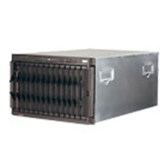
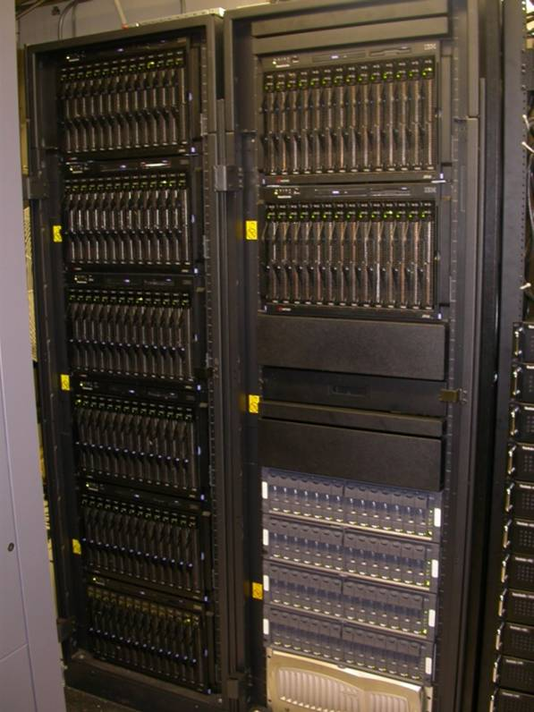
Simplified View of Batch Job Submission
Jobs Queued
job dispatched to run on available host which satisfies job requirements
job_J
job_F
myjob
job_7
Login Node
job routed to queue
sbatch myscript.sbatch
user logged in to login node submits job

Slide 24
Running Programs on Dogwood
Upon ssh-ing to Dogwood, you are on the Login node.
Programs SHOULD NOT be run on Login node.
  Exceptions would be short running commands that don’t use much time, cores or memory
Submit programs to one of the many, many compute nodes.
Submit jobs using SLURM via the sbatch command.

Slide 25
Common batch commands
sbatch
  submit jobs
squeue – view info on jobs is scheduling queue
  squeue –u <onyen>
scancel – kill/cancel submitted job
sinfo -s
  shows all partitions
sacct – job accounting information
  sacct -j <jobid> --format='JobID,user,elapsed, cputime, totalCPU,MaxRSS,MaxVMSize, ncpus,NTasks,ExitCode‘
Use man pages to get much more info!
  man sbatch

Slide 26
Submitting Jobs: sbatch
Submit Jobs - sbatch
  Run large jobs out of scratch space, smaller jobs can run out of your home space
sbatch [sbacth_options] script_name
Common sbatch options:
  -o (--output=) <filename>
  -p (--partition=) <partition name>
  -N (--nodes=)
  -m (--mem=)<memory amount> Note unit is MB but add g to specify GB
  -t (--time=)
  -J (--jobname) <name>
  -n (--ntasks) <number of tasks>
    used for parallel threaded jobs

Slide 27
Two methods to submit jobs
The most common method is to submit a job run script (see following examples)
  sbatch myscript.sbatch
  The file (you create) has #SBATCH entries, one per option followed by the command you want to run
Second method is to submit on the command line using the --wrap option and to include the command you want to run in quotes (“ ”)
  sbatch [sbatch options] --wrap “command to run”

Slide 28
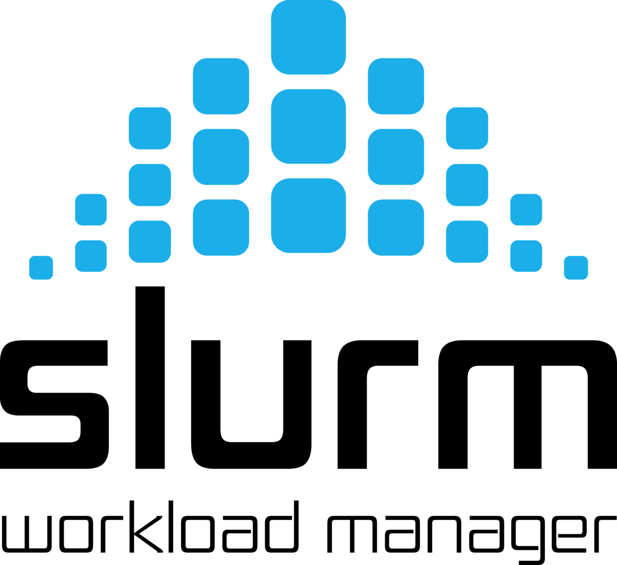
Job Submission Examples

Slide 29
Dogwood Partitions
There are two main partitions that you use
  For 45-528 core jobs, 528_queue, 3 day limit
  For 529-2112 core jobs, 2112_queue, 2 day limit
  These jobs are allocated on different (disjoint) racks in an effort to have more jobs run within a rack
Specialized partitions
  skylake, 50 nodes, 7 day limit
  knl, 20 nodes, 2 day limit
  ms, access to mass storage off login nodes
See
  https://help.unc.edu/help/dogwood-partitions-and-user-limits/

Slide 30
MPI sample job submission
#!/bin/bash
#SBATCH --job-name=first_slurm_job
#SBATCH -N 2
#SBATCH -p 528_queue
#SBATCH --ntasks-per-node=44
#SBATCH --time=5:00:00 # format days-hh:mm:ss
mpirun my_parallel_MPI_job
Submits an MPI job to run on two nodes with 44 tasks on each node.
528_queue partition, 5-day runtime limit
No need to specify memory, you have the whole node
See man sbatch for other time formats

Slide 31
Interactive job submissions
To bring up the Jmol GUI:
srun -n1 --mem=8g --x11=first jmol.sh
Note. For the GUI to display locally you will need a X connection to the cluster.

Slide 32
Printing Job Info at end
#!/bin/bash
#SBATCH --job-name=first_slurm_job
#SBATCH -N 2
#SBATCH -p 528_queue
#SBATCH --ntasks-per-node=44
#SBATCH --time=5:00:00 # format days-hh:mm:ss
mpirun my_parallel_MPI_job
sacct -j $SLURM_JOB_ID --format='JobID,user,elapsed, cputime, totalCPU,MaxRSS,MaxVMSize, ncpus,NTasks,ExitCode'
sacct command at the end prints out some useful information for this job. Note the use SLURM environment variable with the jobid
The format picks out some useful info. See “man sacct” for a complete list of all options.

Slide 33
Run job from command line
You can submit without a batch script, simply use the --wrap option and enclose your entire command in double quotes (“ “)
Include all the additional sbatch options that you want on the line as well
sbatch -t 12:00 -N 2 --ntasks-per-node=44 -o slurm.%j -p 538_partition --wrap=“mpirun myjob”
Note you can mix the “-” and “--xx=“ notations

Slide 34
Email example
#!/bin/bash
…
# comma separated list
#SBATCH --mail-type=BEGIN, END
#SBATCH --mail-user=YOURONYEN@email.unc.edu
# Here are your mail-type options: NONE, BEGIN, END, FAIL,
# REQUEUE, ALL, TIME_LIMIT, TIME_LIMIT_90, TIME_LIMIT_80,
# ARRAY_TASKS

Slide 35

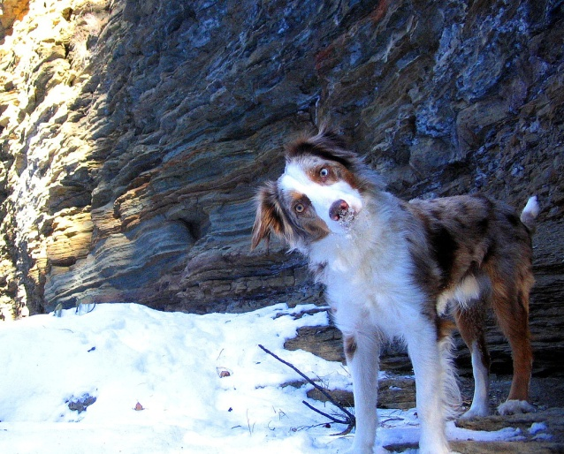




Questions and Comments?
For assistance with any of our services, please contact Research Computing
  Email: research@unc.edu
  Phone: 919-962-HELP
  Submit help ticket at http://help.unc.edu

Slide 36
Supplemental Material

Slide 37
Dogwood – General Compute Nodes
Intel Xeon processers, E5-2699 Av4
Broadwell-EP microarchitecture (14 nm lithography)
Dual socket, 22-core (44 cores per node)
2.4 GHz processors for each core
DDR4 memory, 2400 MHz
55 MB L3 Cache
2x9.6 GT/s QPI (interconnect within the node)
512 GB memory
30 MB L3 cache
145 MW TDP

Slide 38
Dogwood – Skylake Nodes
Intel Xeon Gold 6148 processers
Skylake microarchitecture (14 nm lithography)
Dual socket, 20-core (40 cores per node)
2.4 GHz processors for each core
DDR4 memory, 2666 MHz
10.4 GT/s UPI (Ultar Path replaces QPI)
384 GB memory
27.5 MB L3 cache
150 MW TDP

Slide 39
Dogwood – Knight’s Landing Nodes
Intel Xeon Phi 7210 processers
Knight’s Landing microarchitecture (14 nm lithography)
64 cores each can run 4 threads
1.3 GHz cores
Each core has 2 512-bit vector units and supports AVX-512
TDP 215W

Slide 40
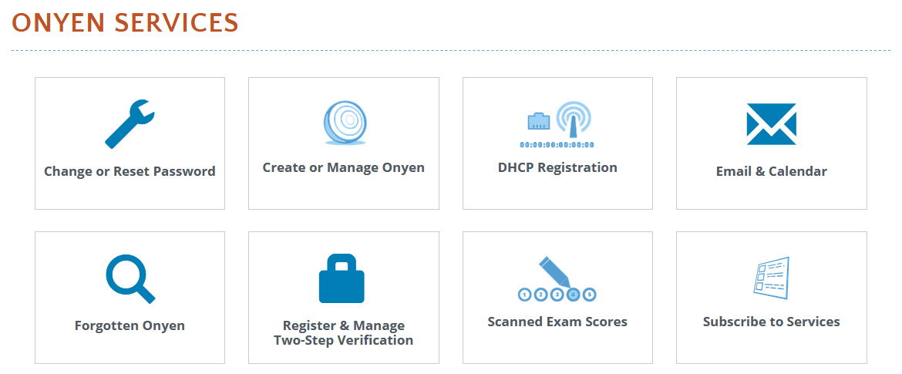
Getting an account:
To apply for your Dogwood or cluster account simply go to
http://onyen.unc.edu
Subscribe to Services

Slide 41
Login to Dogwood
Use ssh to connect:
  ssh Dogwood.unc.edu
  ssh onyen@Dogwood.unc.edu
SSH Secure Shell with Windows
  see http://shareware.unc.edu/software.html
For use with X-Windows Display:
  ssh –X Dogwood.unc.edu
  ssh –Y Dogwood.unc.edu
Off-campus users (i.e. domains outside of unc.edu) must use VPN connection

Slide 42

X Windows
An X windows server allows you to open a GUI from a remote machine (e.g. the cluster) onto your desktop. How you do this varies by your OS
Linux – already installed
Mac - get Xquartz which is open source
  https://www.xquartz.org/
MS Windows - need an application such as X-win32. See
  http://help.unc.edu/help/research-computing-application-x-win32/

Slide 43
File Transfer
Different platforms have different commands and applications you can use to transfer files between your local machine and Dogwood:
Linux– scp, rsync
  scp: https://kb.iu.edu/d/agye
  rsync: https://en.wikipedia.org/wiki/Rsync
Mac- scp, Fetch
  Fetch: http://software.sites.unc.edu/shareware/#f
Windows- SSH Secure Shell Client, MobaXterm
  SSH Secure Shell Client: http://software.sites.unc.edu/shareware/#s
  MobaXterm: https://mobaxterm.mobatek.net/

Slide 44
File Transfer
Globus– good for transferring large files or large numbers of files. A client is available for Linux, Mac, and Windows.
  http://help.unc.edu/?s=globus
  https://www.globus.org/

Slide 45
Dogwood Links
Dogwood page with links
  https://its.unc.edu/rc-services/dogwood-cluster/
Dogwood Getting Started
  https://help.unc.edu/help/getting-started-on-dogwood/
SLURM examples
  https://help.unc.edu/help/dogwood-slurm-examples/
Dogwood partitions
  https://help.unc.edu/help/dogwood-partitions-and-user-limits/

